Slide 1
MUMBAI VS BANGALORE, WHERE TO TRAVEL? LET THE DATA DECIDE!
BY,
AVINASH VIJAYARGAHAVAN

Slide 2
Introduction
India is a great country with a haven of tourism delights like wealth of sights, cultural exuberance, and diversity of terrain. It is no doubt a place of wonder, with creative burst of cultures, races, and religions.
Its diversity is out of all bounds. Indians live with variety and thrive on diversity. From mud hut to mansion, there is variety. Known for its spectacular, India has become a favoured place of visit for travellers from all over the world.
Each state of this wonderful country is unique when it comes to the scenic beauty, nature of the people living in the country and the hospitality of Indians.
While many may have the reasons for travelling, some look at the bustling cities which are to be explored and have an unforgettable experience, but where would city would they want to go to, for starting such a journey?

Slide 3
Problem Statement
Looking at Mumbai and Bangalore as these are the two most important metro cities in India, while also having a war for supremacy in terms of quality of life, jobs, education, entertainment and recreational facilities that these cities have to offer to its residents.
Analysis is done to look at various places in each of these two cities and tries to understand what is popular in them and what they have to offer to someone who is contemplating to make a choice on seeking a life in either of the metro cities.
1. The deciding factors for most would be on how lively, supportive, vibrant and unique each of the cities can be when compared to each other.
2. The business problem in this study assumes that people who would be interested in this study are those who would like to create a projection of potential life and activities in these places if the subject wants to explore one of them.
3. The decision to choose one over the other would depend on popular venues in the area in each of these metro cities.

Slide 4
Data
For this study, we needed data about places in each of these metro cities. The data published by the government on postal codes for all India would serve us well for this study.
We will specifically download the CSV provided under https://data.gov.in/resources/all-india-pincode-directory-contact-details-along-latitude-and-longitude.

Slide 5
Data Cleaning
Read it into a pandas Dataframe and curate it to remove the data related to all other cities, towns, and places which are not Mumbai or Bangalore
Clean up the unnecessary columns in the CSV, which is not relevant or useful for our current study.
Save both the data separately in two different csv files for a faster analysis of the same.
Place names with the same Pincode will be combined as a single row.
Foursquare API will be used to find the longitude and latitude of each of the places in both Mumbai and Bangalore. This will form the dataset we will use for this study.
Combine the rows having the same Pincode, we do this by changing the value of the places by building a comma-separated concatenation of places values for rows with the same Pincode.
We also notice that the longitude and latitude values from the CSV data are not available, which means that we do not have relevant data, we can drop these columns from the dataset as well. We now have the places for both the metro cities.
Enhance the dataset with the required information.
Longitude and Latitude values for the places.
Nominatim library from geocoders.geopy package to find the longitude and latitude for each of the places

Slide 6
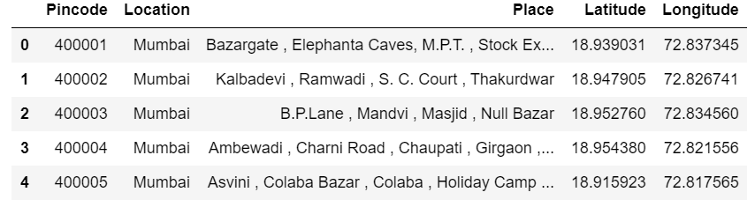
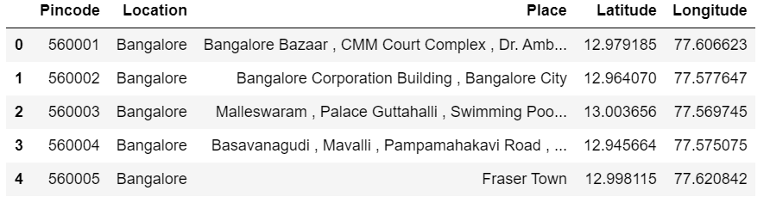
Final Mumbai Data
Final Bangalore Data

Slide 7
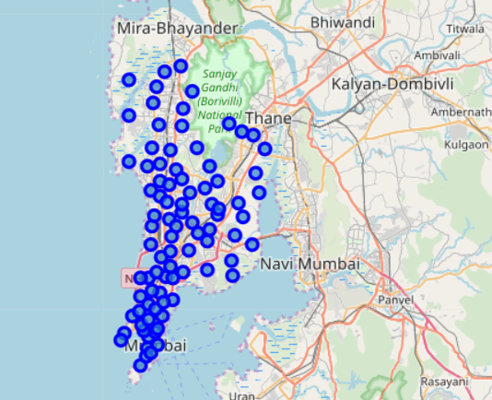
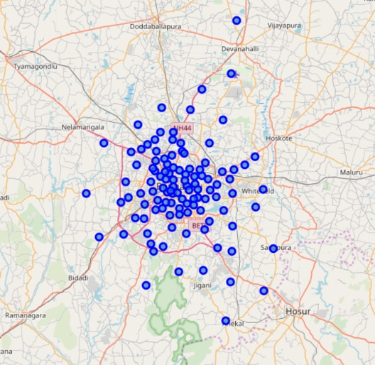
Map of Mumbai with Locations
Map of Bangalore with Locations

Slide 8
Finding top venues near places in Mumbai
Simple Analysis
Foursquare API to find the top venues in the various places of Mumbai.
Foursquare API returns the popular venues within 500m radius of these places.
Employing statistically and analytical methods to find the unique venues/venue categories for these places and we will build a dataframe that calibrates each of the place with the frequency of occurrence for each of the venue category.
Creation of dataset that lists the top 5 common venues against each of the places.
183 unique venue categories of places in Mumbai. Yoga studios,
Bars, Flea markets, Gourmet shops, Night Clubs, Pubs, Bagel shops, Pharmacies and Spas being some of them.

Slide 9
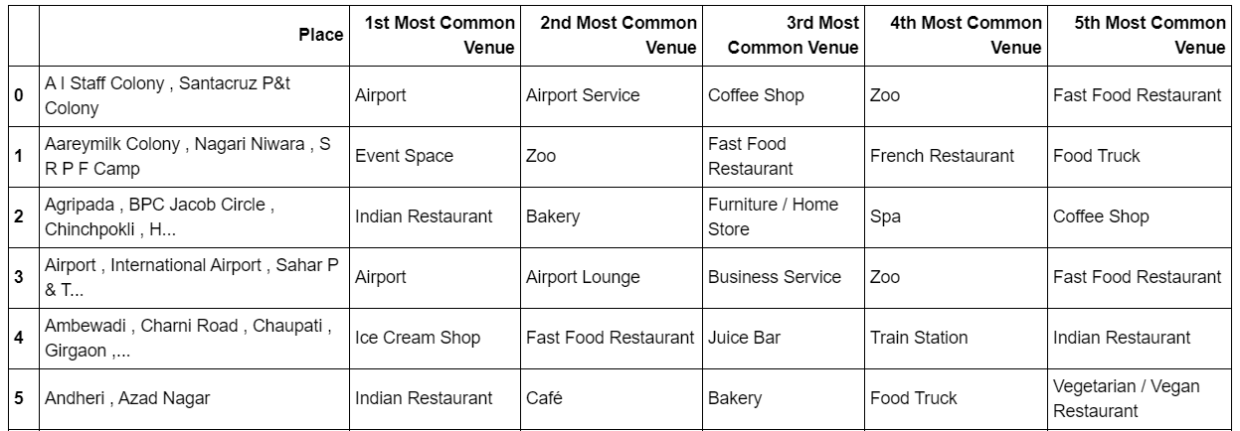
Most common venues in Mumbai
Highest 1st Most Common Venue: Indian Restaurant
Highest 2nd Most Common Venue: Cafe
Highest 3rd Most Common Venue: Bakery
Highest 4th Most Common Venue: Zoo
Highest 5th Most Common Venue: Food truck

Slide 10
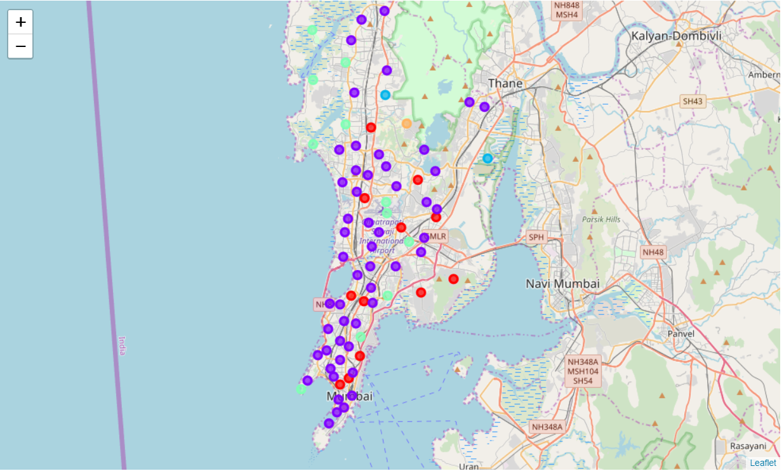
Cluster Analysis
Applying a clustering algorithm to group the places based on the similarity in types of venues they have. By clustering, we also provide information to users on a common type of place in Mumbai.
Using the k-Means clustering approach to cluster the places. k will be selected as 5. This means that we will group the places into 5 clusters. Each of the places gets a Cluster Label assigned.
Use the dataset with cluster labels assigned to visualize the clusters in a folium map.
Let us now dig a little deeper into how the places are clustered and what is the characteristic of the cluster that is very common across most places in Mumbai.

Slide 11
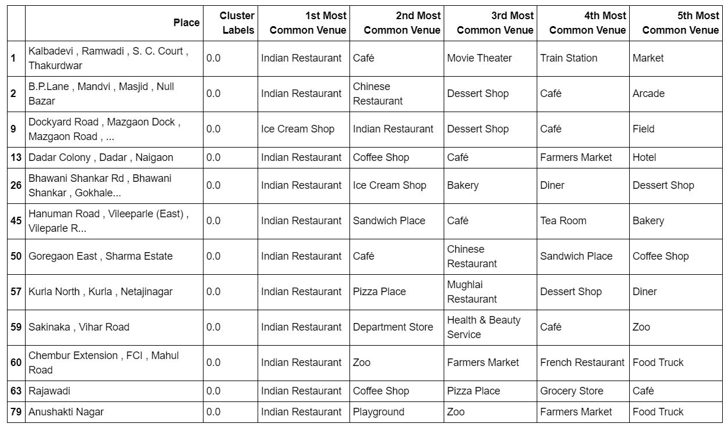
Cluster 1
The places belonging to this cluster is popular for having various restaurants which are majorly Indian, along with cafes and market areas.
We see that these place would be something that a traveller would prefer if they are a foodie or are more into knowing about food-related areas.

Slide 12
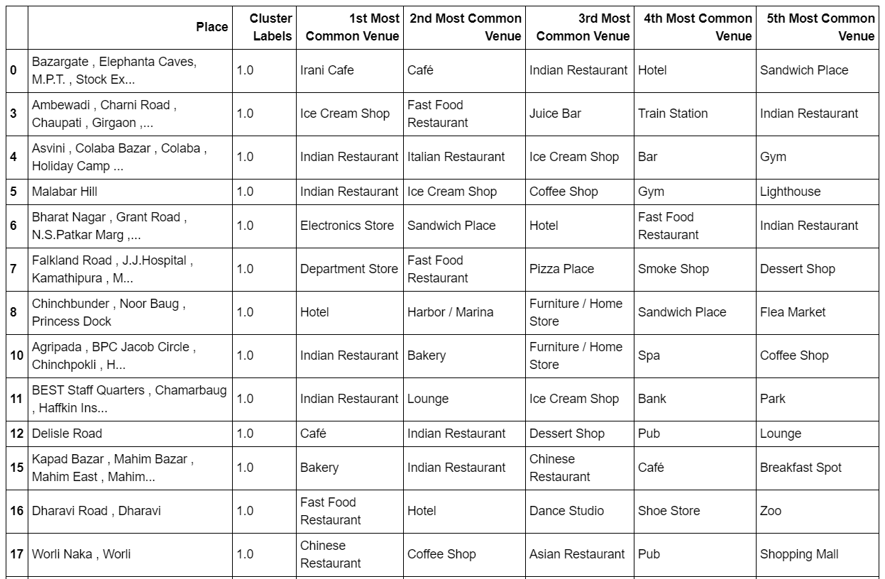
Cluster 2
The places belonging to this cluster is popular for having many shops, along with shopping malls, with some stores, hotels and pubs.
We see that these place would be something that a traveller would prefer if they need to do some shopping along with where they would normally stay.

Slide 13
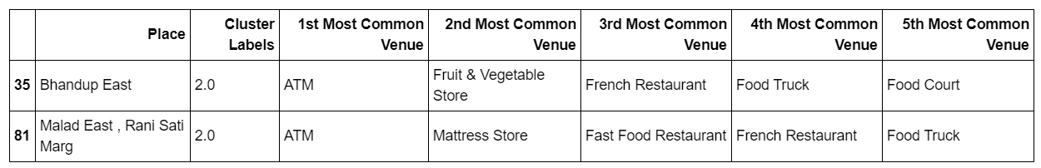
Cluster 3
Not many places belong to this cluster, ATM’s, Food trucks and some stores are popular values close to these places.

Slide 14
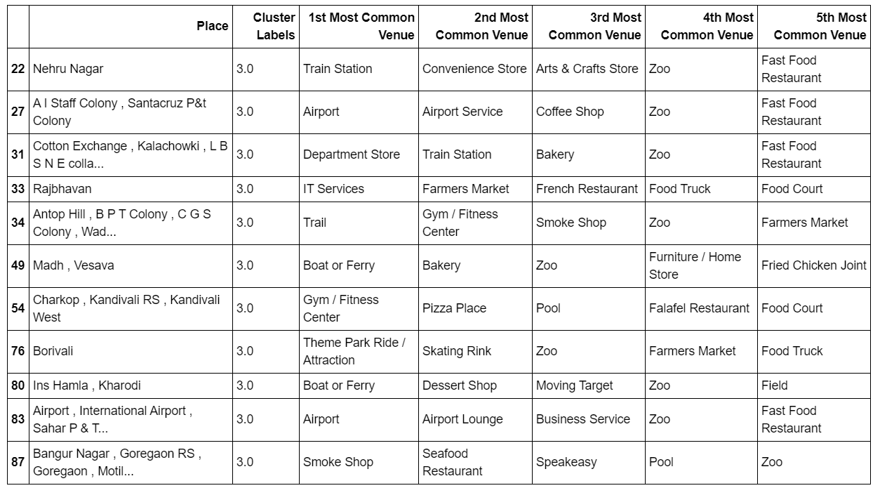
Cluster 4
The places belonging to this cluster is popular for travelling towards places, like the train station, airports, boats or ferry and also other entertainment areas.
We see that these place would be something that a traveller would prefer if they have to move from on place to another and for various attractions.

Slide 15
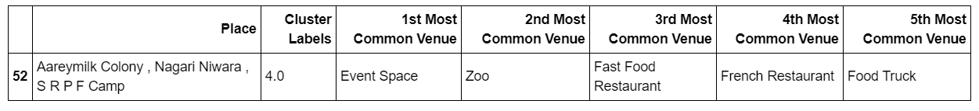
Cluster 5
Not many places belong to this cluster, Event Space, Zoos and restaurants stores are popular values close to these places.

Slide 16
Finding top venues near places in Bangalore
Foursquare API to find the top venues in the various places of Bangalore and employ statistically and analytical methods to find the unique venues/venue categories for these places and we will build a dataframe that calibrates each of the place with the frequency of occurrence for each of the venue category.
There are 175 unique venue categories of places in Bangalore.
Design studios, Event Spaces, Hot Springs, Lakes, Burger joints, Tea shops, theatres, Boutiques, Breweries, Bars, Flea markets, Fish Markets, Night Clubs, Parks, Shoping Malls and Departmental Stores being some of them.
Creation of dataset that lists the top 5 common venues against each of the places in Bangalore.

Slide 17
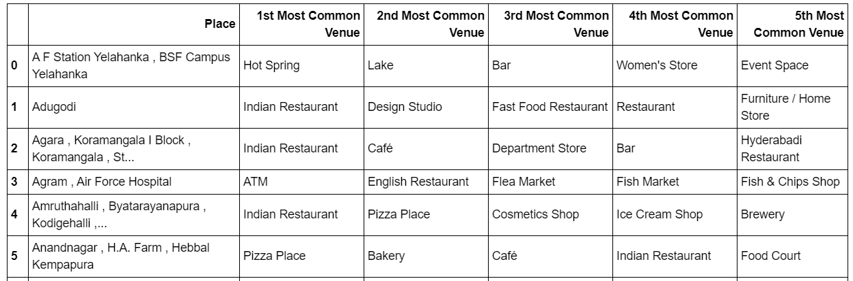
Most common venues in Bangalore
Highest 1st Most Common Venue: Indian Restaurant
Highest 2nd Most Common Venue: Pizza Place
Highest 3rd Most Common Venue: Flea Market
Highest 4th Most Common Venue: Fish Market
Highest 5th Most Common Venue: Fish and Chip Shop

Slide 18
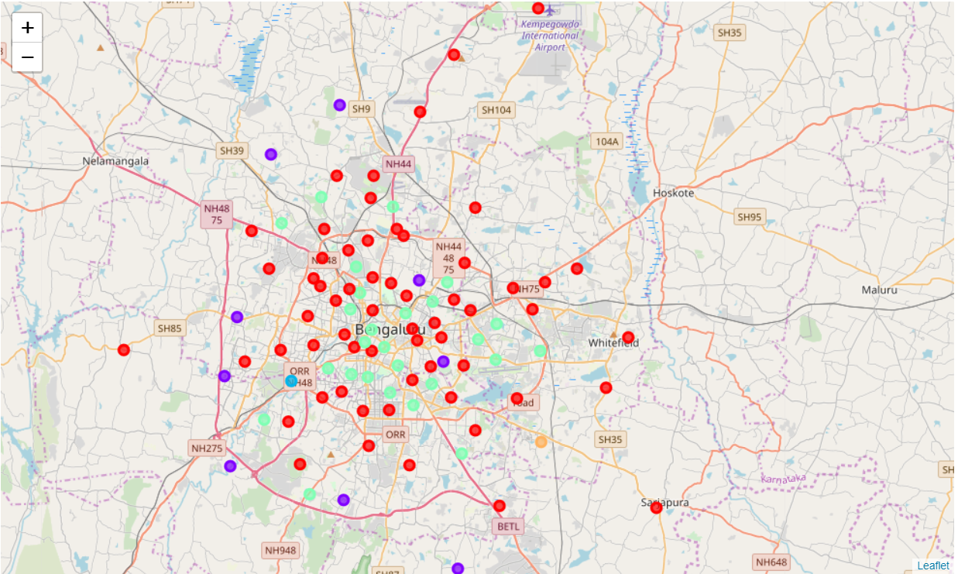
Cluster Analysis
Applying a clustering algorithm to group the places based on the similarity in types of venues they have. By clustering, we also provide information to users on a common type of place in Bangalore.
Using the k-Means clustering approach to cluster the places. k will be selected as 5. This means that we will group the places into 5 clusters. Each of the places gets a Cluster Label assigned.
Use the dataset with cluster labels assigned to visualize the clusters in a folium map.
Let us now dig a little deeper into how the places are clustered and what is the characteristic of the cluster that is very common across most places in Bangalore.

Slide 19
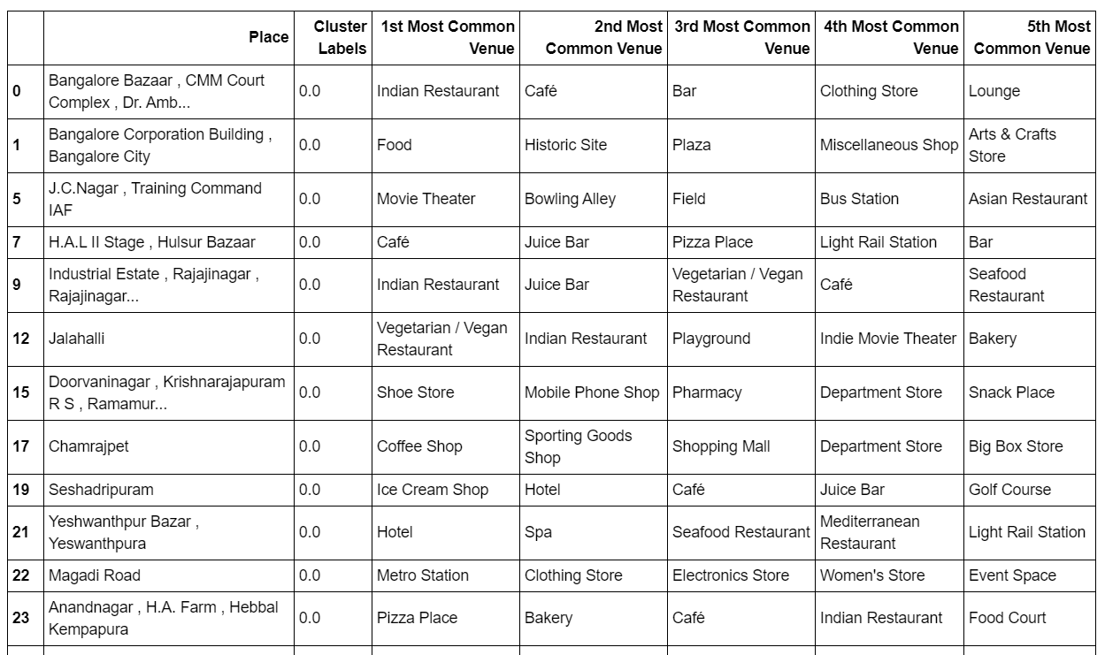
Cluster 1
The places belonging to this cluster is popular for travelling towards places to stay with hotels, various shops and restaurants, with historic sites and fields.
We see that these place would be something that a traveller would prefer if they has to stay and also look for various historic sites.

Slide 20
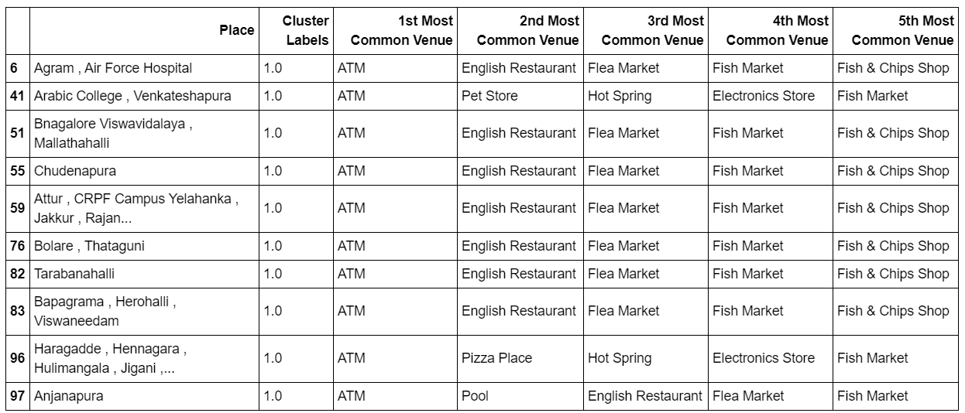
Cluster 2
The places belonging to this cluster is popular for travelling towards places for collecting money via ATMs, going towards flea and fish markets, along with fish and chip shops.
We see that these place would be something that a traveller would prefer if they may do shopping or more into fish-related areas.

Slide 21
Cluster 3
Not many places belong to this cluster, Miscellaneous Shop, Flea Market and Hotel Bar are popular values close to these places.

Slide 22
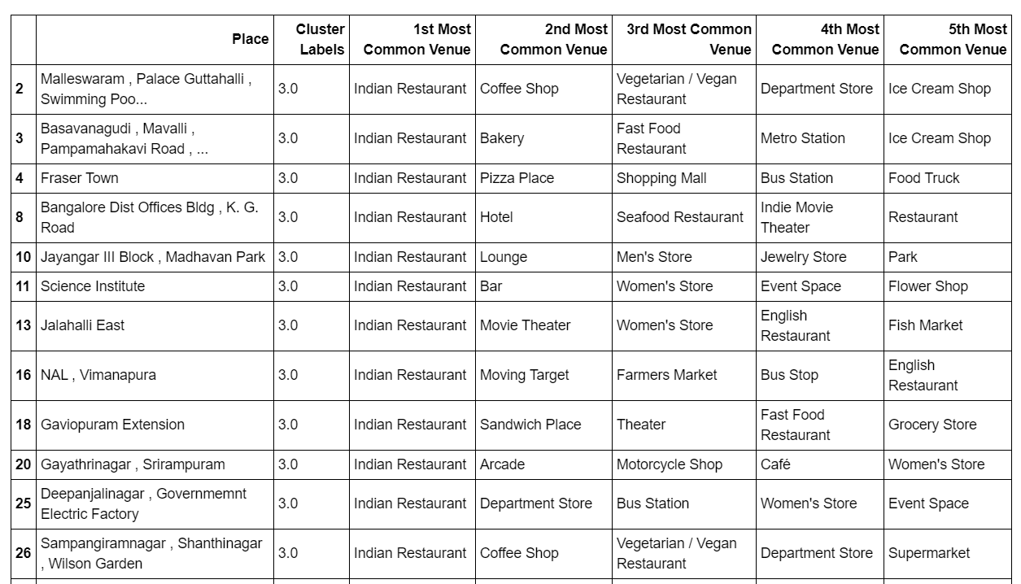
Cluster 4
The places belonging to this cluster is popular for travelling towards places for majorly Indian restaurants, with various other amenities such as departmental stores, shopping malls and so on.
We see that these places would be something that a traveller would prefer for being a foodie or rather try out Indian restaurants as a whole.

Slide 23
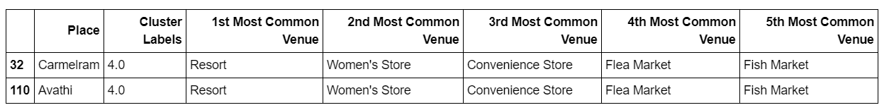
Cluster 5
Not many places belong to this cluster, Resorts, Flea Market and Convenience Store are popular values close to these places.

Slide 24
Results
Intention – To analyze and understand the difference in the type of life in these metros, which can offer decision points for anybody who is considering to settle in either of the metro cities and can get a peek into what type of experience and facilities he will be provided with.
Given our cluster information for both Mumbai and Bangalore, we see that
Mumbai and its neighbourhoods are a great place for a foodie. There are a lot of restaurants, cafes, bars, etc in places of Mumbai. Also due to the proximity of Mumbai to the seashore, places in Mumbai offer for harbours, seafood, boat, and ferry rides.
While for Bangalore, it is definitely more popular for being a shopping district considering there are many shops and shopping malls surrounded around the areas, and also containing various markets ranging from flea to fish markets.
Thus, we can say that if a person travelling is a foodie then he should definitely go for Mumbai, while if the person travelling is interested in shopping, then they should visit Bangalore instead.

Slide 25
Discussions
There were certain places which didn’t have venues, which were eventually cut from the data for better understanding as well.
There was some restricitions in using the Foursquare API in general, while some clustering data was not available, to which were removed in the final data.

Slide 26
Conclusion
Thus with this project, we have analysed the kind of life each of these big metro cities has to offer based on the popular venues in the places of each city.
Another important aspect the study reveals is that the categories of venues Mumbai offers more as compared to Bangalore.
This means that Bangalore becomes restrictive in terms of variety and convenience.
Thus, looking at all things considered, the traveller should go for Mumbai, considering its vast amount venues it offers, along with the ease of transport and is perfect for foodies to try Indian cuisines.

Slide 27
THANK YOU

